Slide 1
Battle For Middle Earth
Ece Altınyollar
Arif Can Terzioğlu
Raza Faraz
Emin Tosun
Instructor: Bora Güngören

Slide 2
Installation
- Java Runtime environment must be installed.
- 1 GB of memory.
- Mnimum of 1280 x 720 resolution.
-SQLite was used.
Java Swing Library

Slide 3
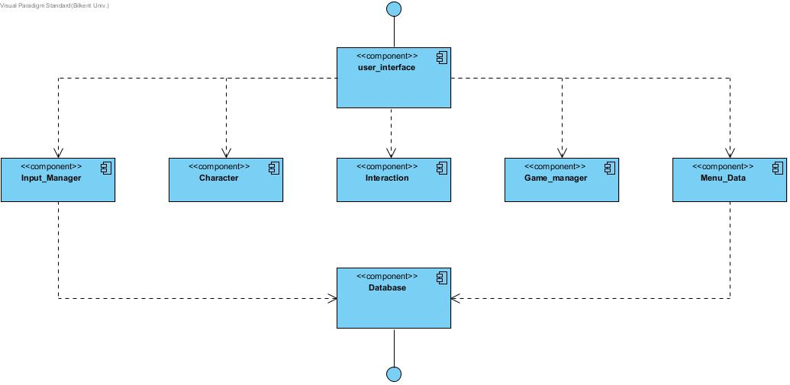
3 Tier Architecture

Slide 4
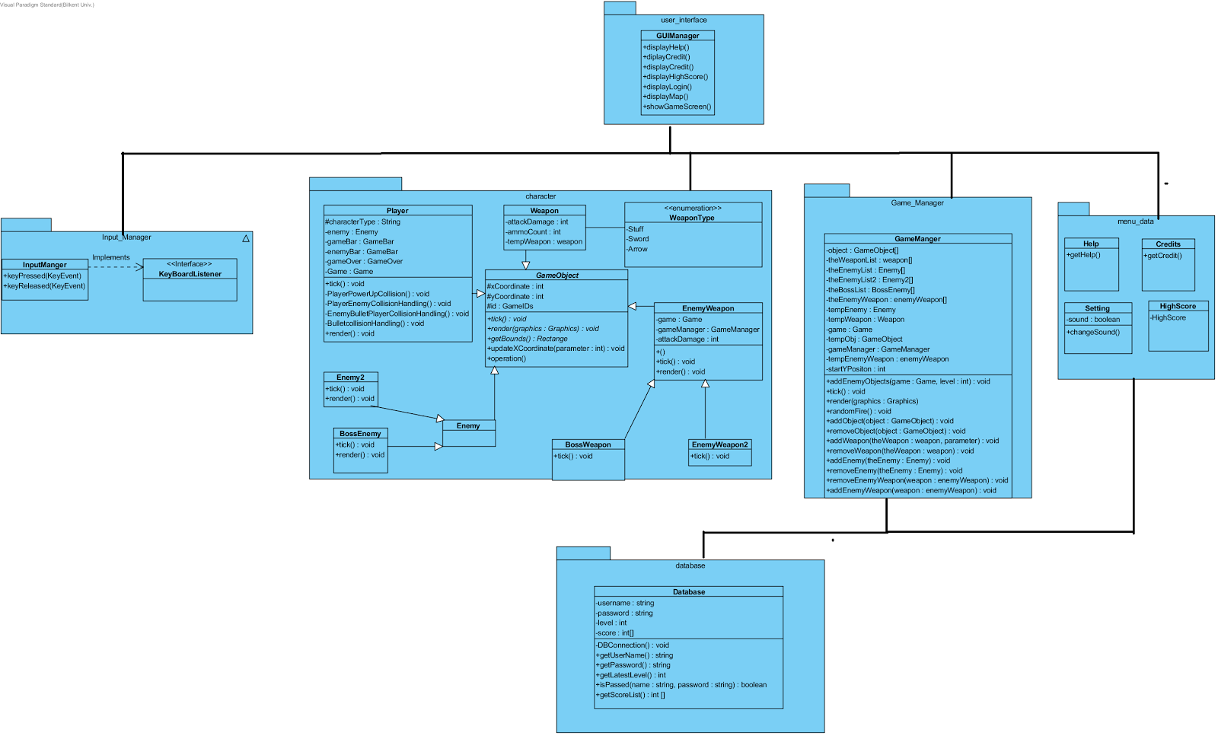

Slide 5
Design Pattern
The Façade class is the ‘game manager’ class, as this class handles most of the main functions of the game.
Most of the classes are linked with this class thus any alteration to this façade class will directly have an effect on the other components of this subsystem.

Slide 6
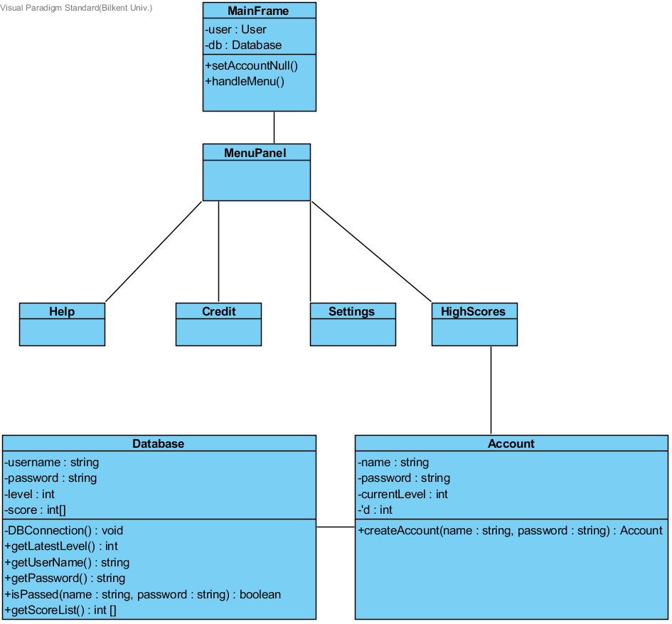

Slide 7
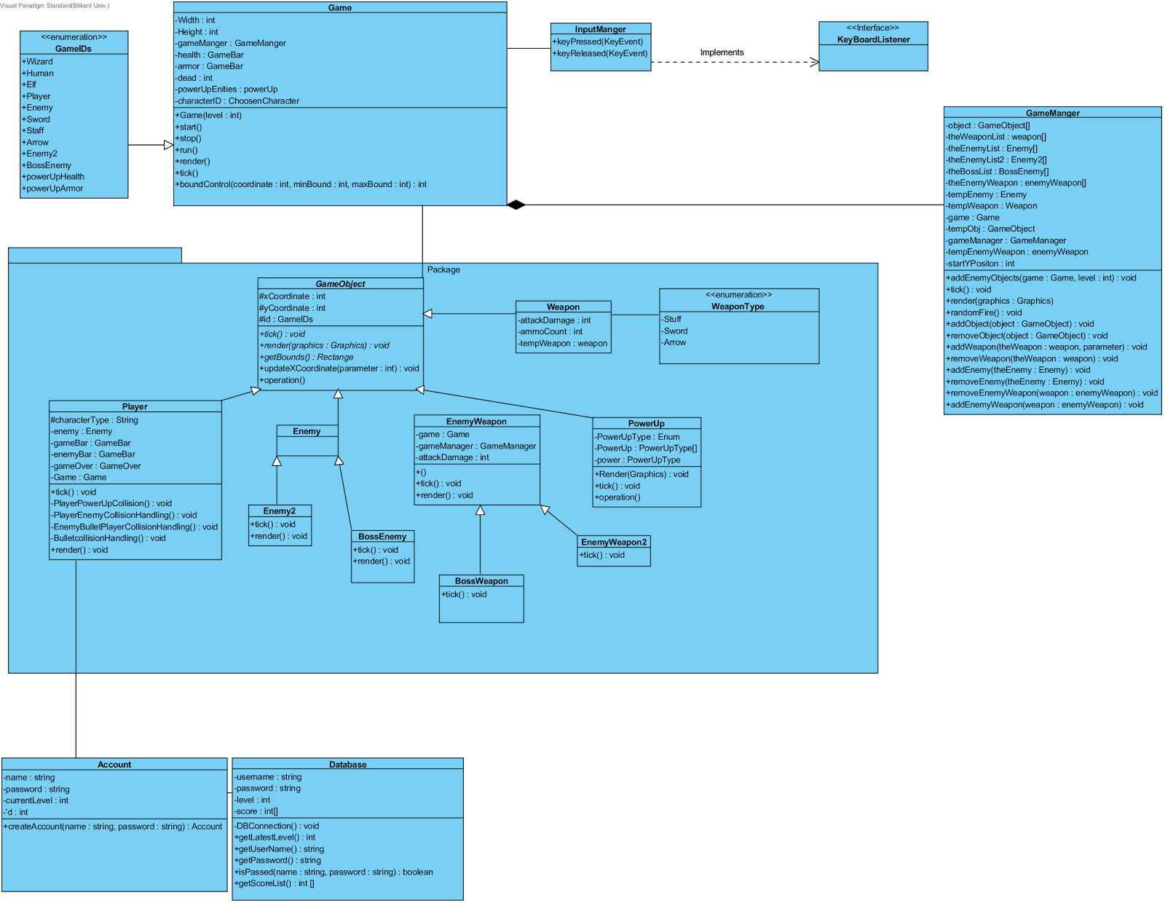

Slide 8
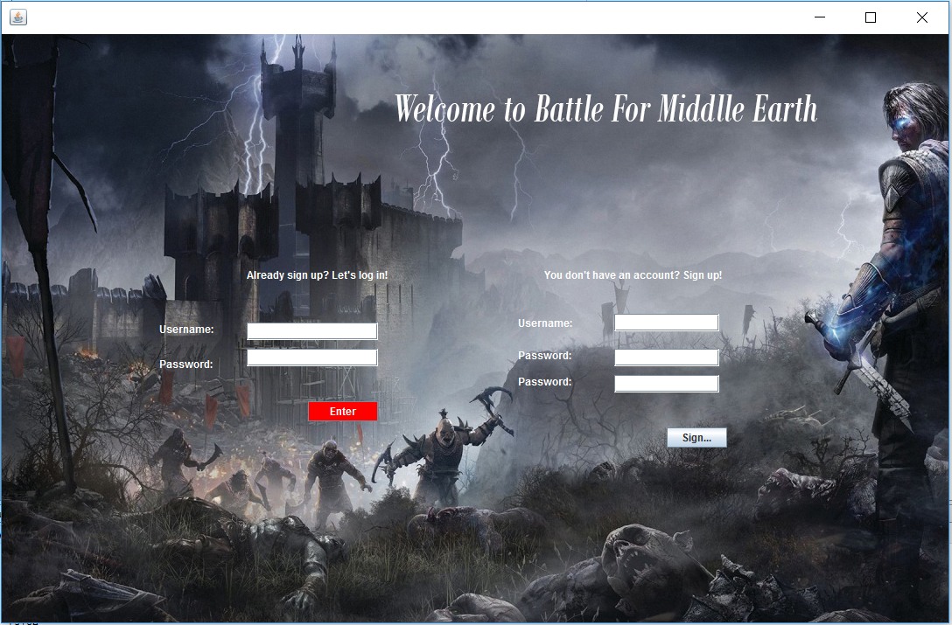

Slide 9
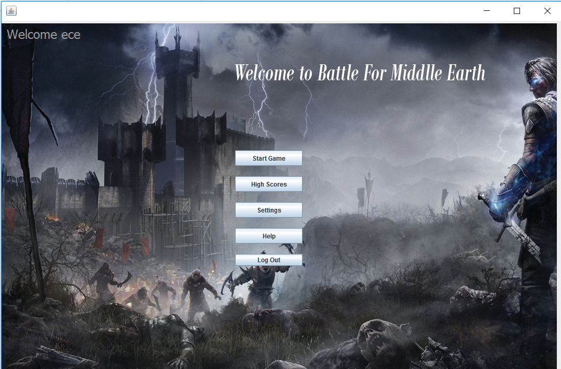

Slide 10
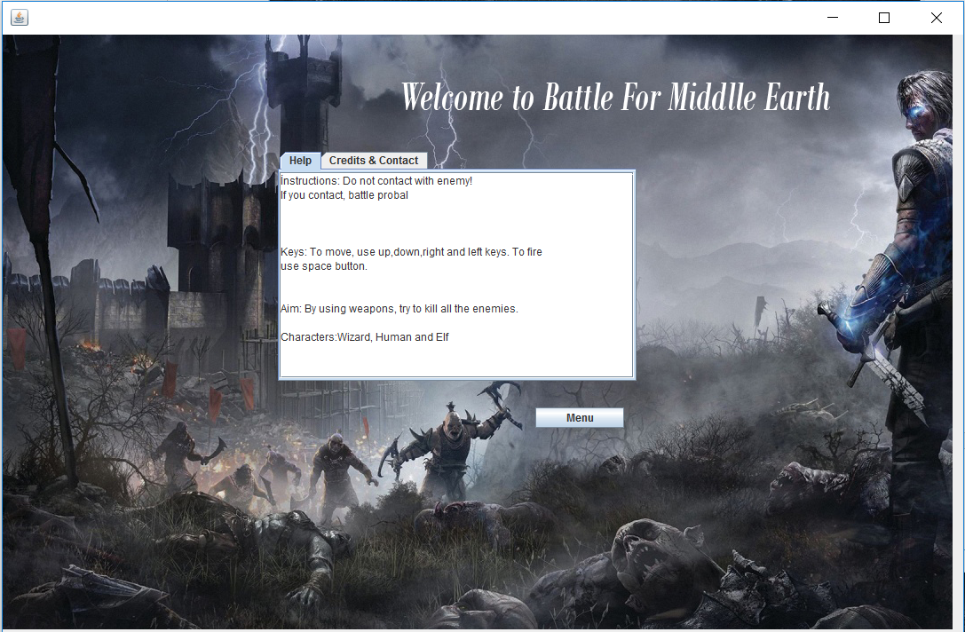

Slide 11
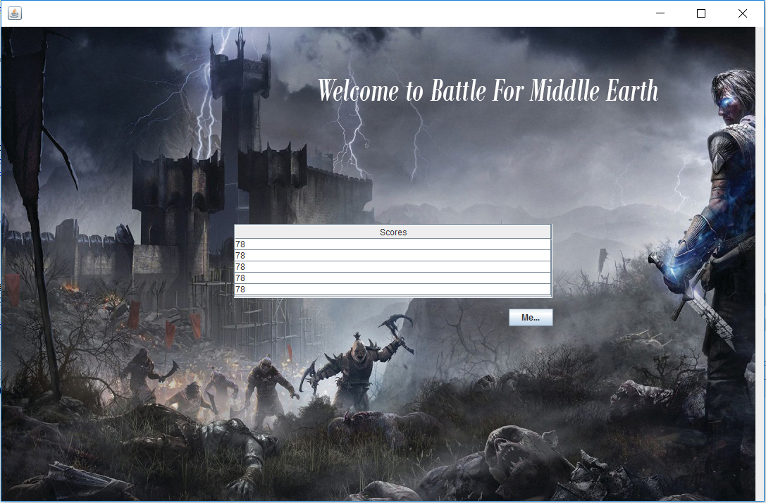

Slide 12
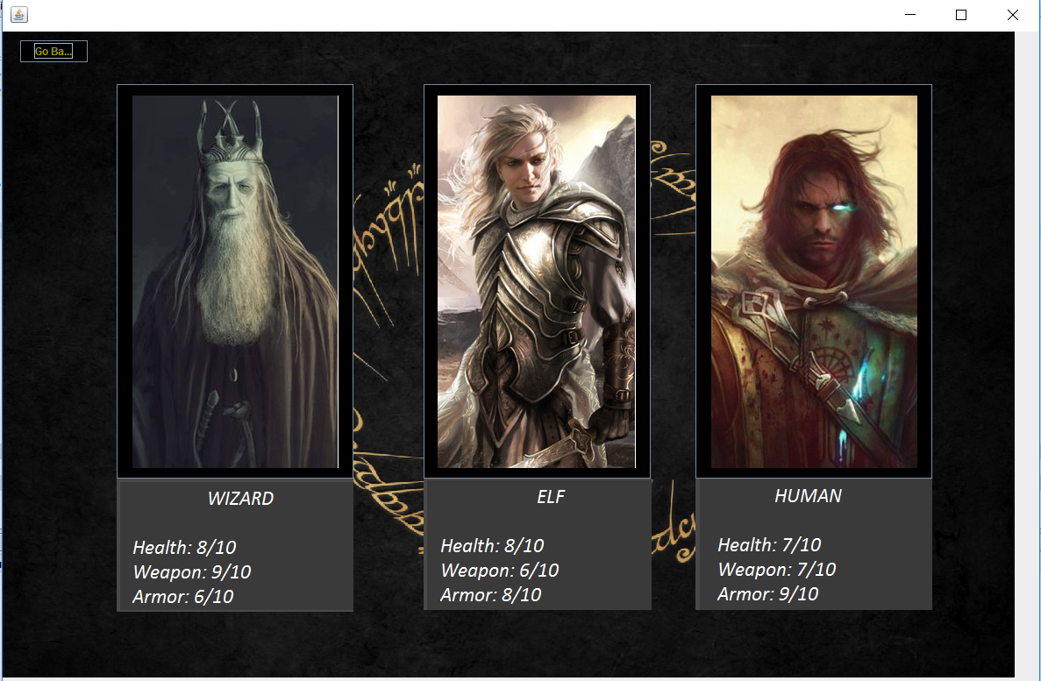

Slide 13
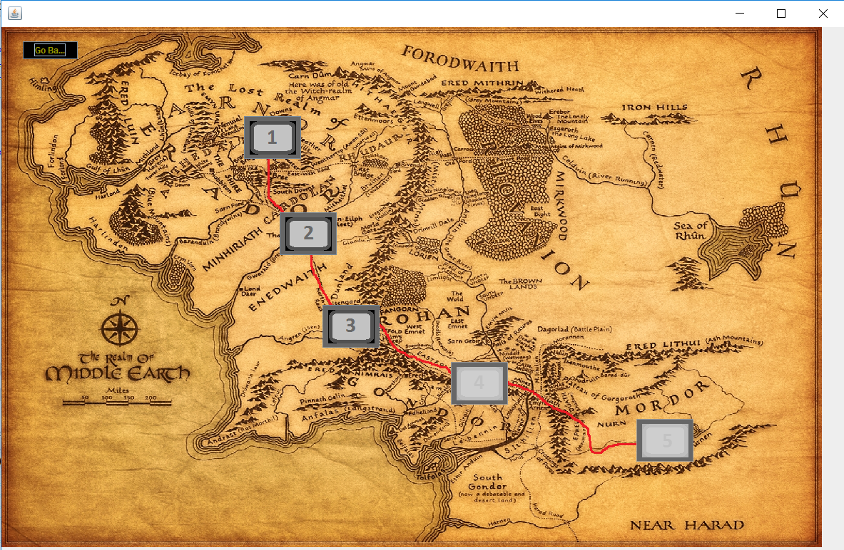

Slide 14
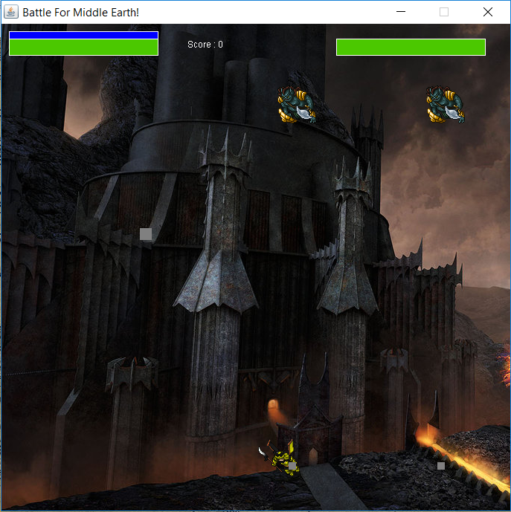

Slide 15
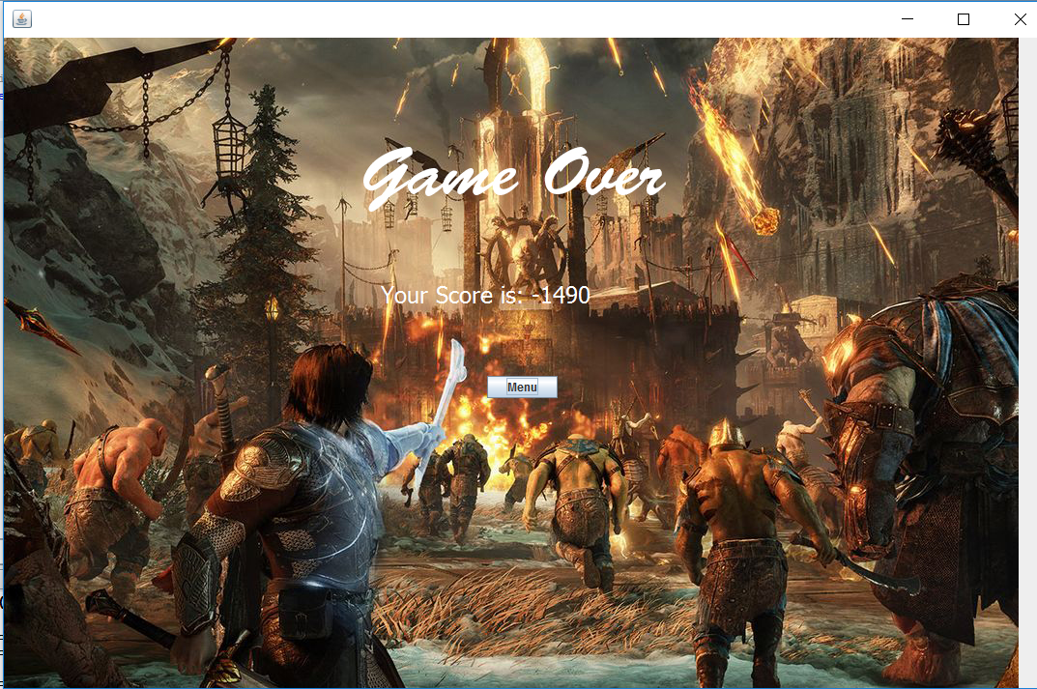

Slide 16
Non Implemented Specifications and Changes
Changed
In terms of our implentation , we were originally stated in the report that we will use FX GUI library , but we implemented the project in swing. Additionally there were some changes to our UML diagram, firstly we removed the collision class and the player subclasses , such as Human , elf and Wizard. Instead of this , we included the functionality of these classes inside the ‘Player’ class. In addition in order to decrease the decoupling aspect we included the Façade class ‘Game Object’ class. Finally we also added a GameIDs enum type class to keep track of all the individual game attributes in the game.
NonImplemented
· We were not able to implement the setting menu of the game.
· For this game we also were not able to include sound-effects / music
· We also did not include the pause menu
· Instead of a limited set of game ammo the user will enjoy unlimited ammo
· In terms of Power up , we were not able to include Weapons upgrade.
· There are no unique character skills.

